Slide 1

MCOM COMPANY REPORT
Issues & Recommendations

Slide 2

MCOM Situational Analysis
Internal and External Analysis
Market
Service Provided
Growth
12%
Business Solutions
Subscriber
Voice and Data Services
11%
Messaging
250 million subscribers
Mobile Penetration
Value Added Services

Slide 3
MCOM Situational Analysis
Internal and External Analysis
Market
Service Provided
Growth
12%
Business Solutions
Subscriber
Voice and Data Services
11%
Messaging
250 million subscribers
Mobile Penetration
Value Added Services

Slide 4
MCOM Situational Analysis
Internal and External Analysis
Market
Service Provided
Growth
12%
Business Solutions
Subscriber
Voice and Data Services
11%
Messaging
250 million subscribers
Mobile Penetration
Value Added Services

Slide 5




MCOM’s Issues Prioritization
Time
Financial
Reputational
Long Term

Slide 6
MCOM’s Issues Prioritization
Time, Financial, Reputational, Long Term
#1
#2
#3
#4
#5
Security Crisis and Legal Wrangling in Nakolia
Political Risk and Strategic Uncertainty in Ilania
Shared Services Center in Sadimba
Nakolia and MCOM Capital Structure
Mobile Operator License in Chininsia
Settle court process in Nakolia, ASAP
Sustainable Growth

Slide 7
MCOM’s Issues Prioritization
Time, Financial, Reputational, Long Term
#1
#2
#3
#4
#5
Security Crisis and Legal Wrangling in Nakolia
Political Risk and Strategic Uncertainty in Ilania
Shared Services Center in Sadimba
Nakolia and MCOM Capital Structure
Mobile Operator License in Chininsia
Sell off and walk out from Ilania
Sustainable Growth

Slide 8
MCOM’s Issues Prioritization
Time, Financial, Reputational, Long Term
#1
#2
#3
#4
#5
Security Crisis and Legal Wrangling in Nakolia
Political Risk and Strategic Uncertainty in Ilania
Shared Services Center in Sadimba
Nakolia and MCOM Capital Structure
Mobile Operator License in Chininsia
Continue to process SSC in Sadimba.
Sustainable Growth

Slide 9
MCOM’s Issues Prioritization
Time, Financial, Reputational, Long Term
#1
#2
#3
#4
#5
Security Crisis and Legal Wrangling in Nakolia
Political Risk and Strategic Uncertainty in Ilania
Shared Services Center in Sadimba
Nakolia and MCOM Capital Structure
Mobile Operator License in Chininsia
Sell and leaseback the towers in Nakolia.
Sustainable Growth

Slide 10
MCOM’s Issues Prioritization
Time, Financial, Reputational, Long Term
#1
#2
#3
#4
#5
Security Crisis and Legal Wrangling in Nakolia
Political Risk and Strategic Uncertainty in Ilania
Shared Services Center in Sadimba
Nakolia and MCOM Capital Structure
Mobile Operator License in Chininsia
Acquire CloudNet
Sustainable Growth

Slide 11
MCOM’s Issues Prioritization
Time, Financial, Reputational, Long Term
#1
#2
#3
#4
#5
Security Crisis and Legal Wrangling in Nakolia
Political Risk and Strategic Uncertainty in Ilania
Shared Services Center in Sadimba
Nakolia and MCOM Capital Structure
Mobile Operator License in Chininsia
Settle court process in Nakolia, ASAP
Sell off and walk out from Ilania
Continue to process SSC in Sadimba.
Sell and leaseback the towers in Nakolia.
Acquire CloudNet
Sustainable Growth

Slide 12



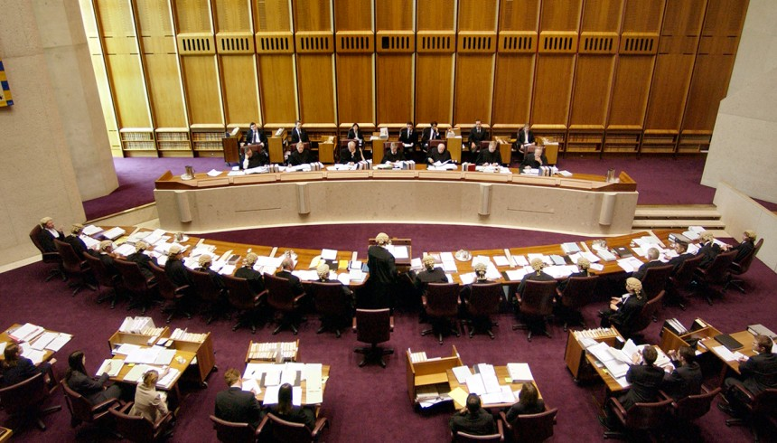
Presentation Outline
PRIORITIZATION
ANALYSIS
RECOMMENDATION
& ACTION PLAN
ETHICAL ISSUES

Slide 13
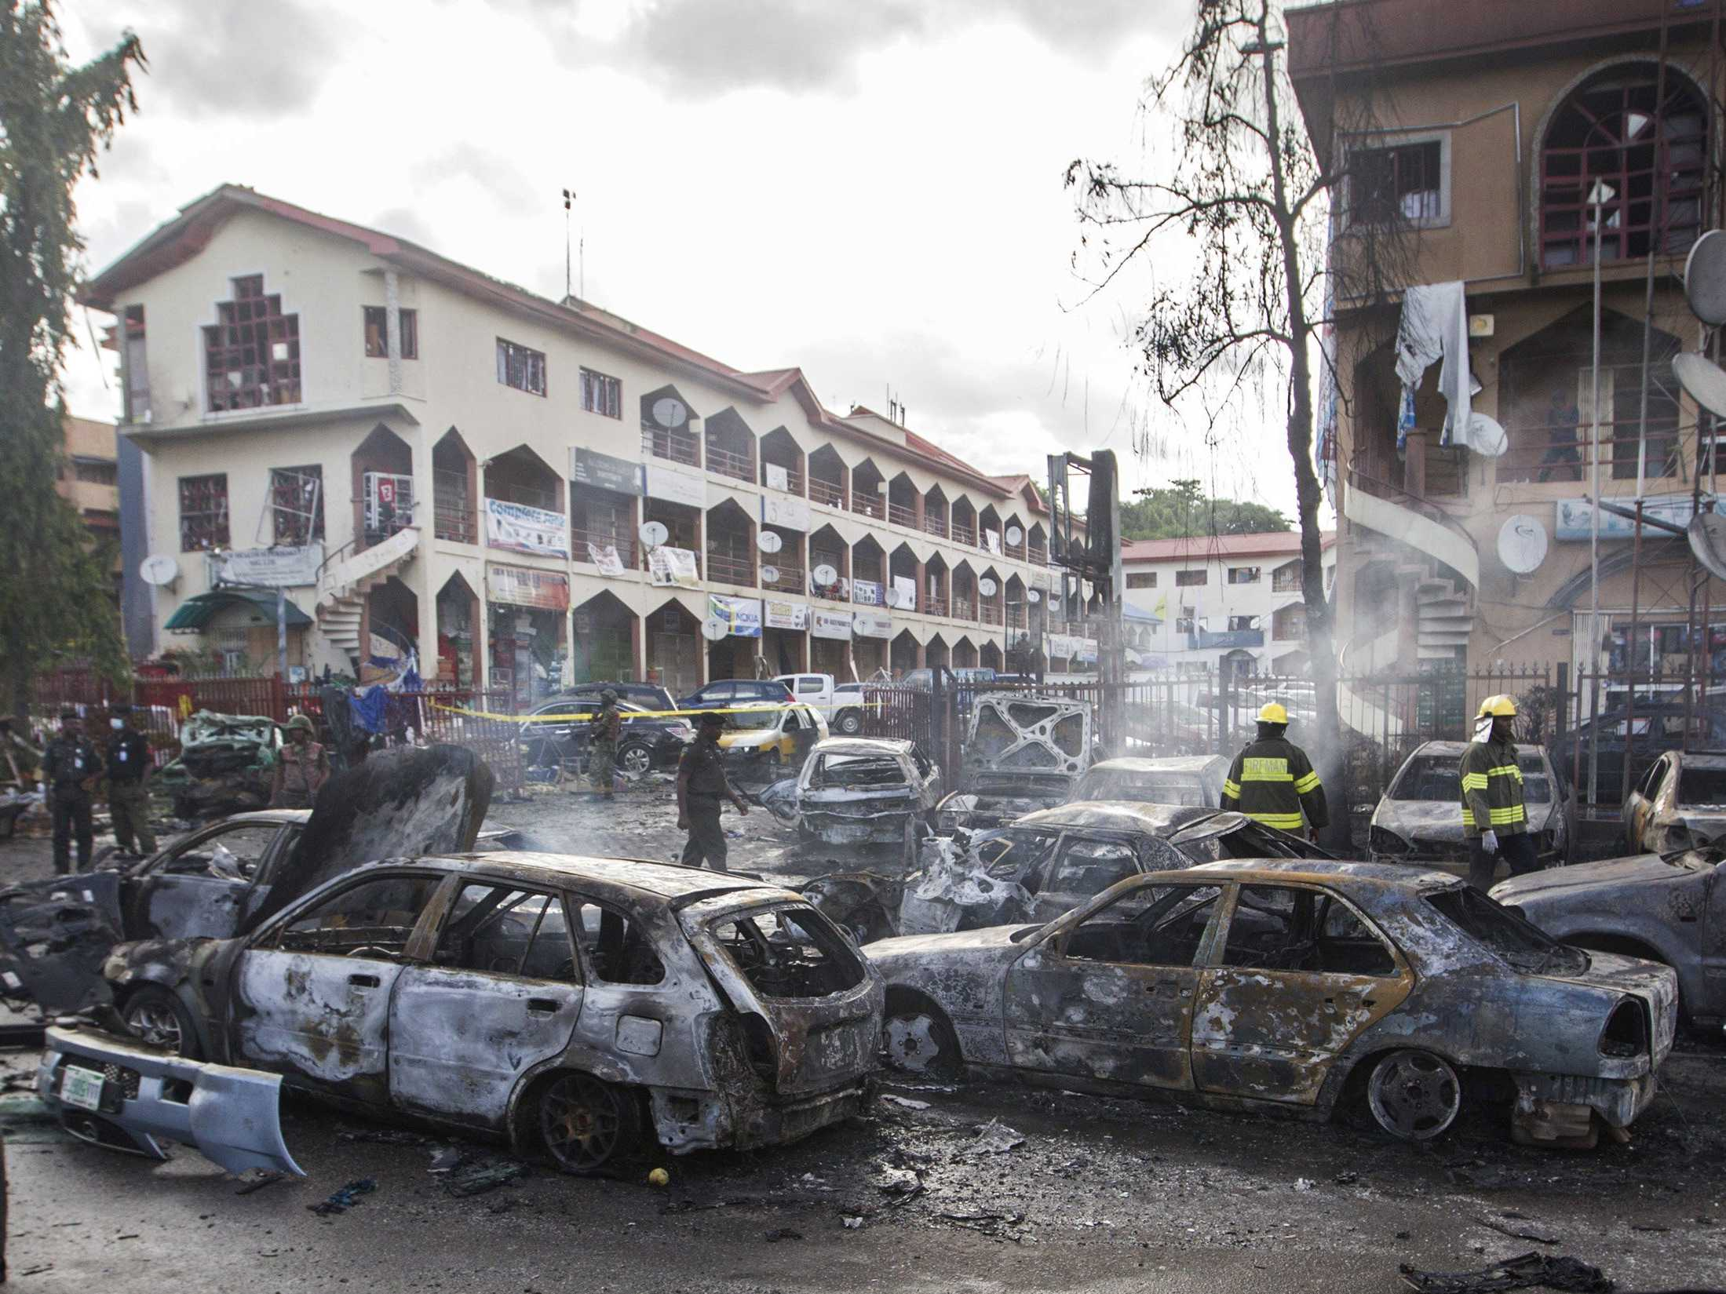
Issue #1: Security Crisis & Legal Wrangling in Nakolia
Noncompliance leading to fine and tarnished image
US$ 3.9 bil
Post-negotiation bad publicity
LEGAL WRANGLING IN NAKOLIA
UNCERTAINTY IN ILANIA
SSC IN SADIMBA
MCOM CAPITAL STRUCTURE
MOBILE OPERATOR LICENSE IN CHININSIA

Slide 14
The Impacts
Financial, Strategic, and Reputation Impacts caused by the issue
Risk of failure to pay
25%
36%
Fall of market capitalization
Of 2015’s turnover
LEGAL WRANGLING IN NAKOLIA
UNCERTAINTY IN ILANIA
SSC IN SADIMBA
MCOM CAPITAL STRUCTURE
MOBILE OPERATOR LICENSE IN CHININSIA
Notes:
36% turnover?? Minta datanya

Slide 15
The Impacts
Financial, Strategic, and Reputation Impacts caused by the issue
STRATEGIC & REPUTATION IMPACTS
SHAREHOLDERS:
Questioning performance’s stability
CUSTOMERS’S TRUST:
“Supporting terrorist action” image
Endangered market leader strategic position
LEGAL WRANGLING IN NAKOLIA
UNCERTAINTY IN ILANIA
SSC IN SADIMBA
MCOM CAPITAL STRUCTURE
MOBILE OPERATOR LICENSE IN CHININSIA

Slide 16


Alternatives
SECURITY CRISIS & LEGAL WRANGLING IN NAKOLIA
#1.
#2.
COURT SETTLEMENT & ACCEPT US$ 3.9 BIL FINE
CONTINUE TO PURSUE
COURT ACTION
Regain stakeholders’ trust
Low chance for fine reduction
Stall to get money to pay fine
Worsen MCOM’s reputation
LEGAL WRANGLING IN NAKOLIA
UNCERTAINTY IN ILANIA
SSC IN SADIMBA
MCOM CAPITAL STRUCTURE
MOBILE OPERATOR LICENSE IN CHININSIA
Notes:
The first alternatives for this issue is to continue pursue court action to challenge the fine which you have been done. We can hope there will be further fine reduction, and stalling to get the money to pay the fine. However, doing this action could worsen your reputation in the eye of our stakeholders.
The second alternative is to finish the court action and accept the US$ 3.9 bil fine. By doing this action, we can gain our shareholders, government, and the market’s trust.

Slide 17
Alternatives
SECURITY CRISIS & LEGAL WRANGLING IN NAKOLIA
#1.
#2.
COURT SETTLEMENT & ACCEPT US$ 3.9 BIL FINE
CONTINUE TO PURSUE
COURT ACTION
Regain stakeholders’ trust
Low chance for fine reduction
Stall to get money to pay fine
Worsen MCOM’s reputation
LEGAL WRANGLING IN NAKOLIA
UNCERTAINTY IN ILANIA
SSC IN SADIMBA
MCOM CAPITAL STRUCTURE
MOBILE OPERATOR LICENSE IN CHININSIA
Notes:
The first alternatives for this issue is to continue pursue court action to challenge the fine which you have been done. We can hope there will be further fine reduction, and stalling to get the money to pay the fine. However, doing this action could worsen your reputation in the eye of our stakeholders.
The second alternative is to finish the court action and accept the US$ 3.9 bil fine. By doing this action, we can gain our shareholders, government, and the market’s trust.

Slide 18
Action Plan
SECURITY CRISIS & LEGAL WRANGLING IN NAKOLIA
Court settlement & accept the fine
Pay initial payment to government
All active user to register number & anti terrorism campaign
Pursue better term of payment
LEGAL WRANGLING IN NAKOLIA
UNCERTAINTY IN ILANIA
SSC IN SADIMBA
MCOM CAPITAL STRUCTURE
MOBILE OPERATOR LICENSE IN CHININSIA
Notes:
1. Take back the court action in order to show MCOM want to comply with government rules
2. MCOM needs to show a “good will” of being responsible and paying all the fine that has been given to MCOM by giving an initial payment to the government.
3. Rather than doing negotiation to lower the fine, it is better for MCOM to accept the amount of fine given and pursue for a better term of payment.
4. Announce a regulation for all active user that they need to register their phone number by the end of predetermined time or else their number will be deactivated.
5. Create a campaign that MCOM is also against terrorism.

Slide 19

Issue #2: Political Risks & Strategic Uncertainty in Ilania
S$ 4.2 Bil
Dividend
Political Unstability
Cannot be Retrieved
S$ 5.8 Bil
Loan Receivable
LEGAL WRANGLING IN NAKOLIA
UNCERTAINTY IN ILANIA
SSC IN SADIMBA
MCOM CAPITAL STRUCTURE
MOBILE OPERATOR LICENSE IN CHININSIA

Slide 20
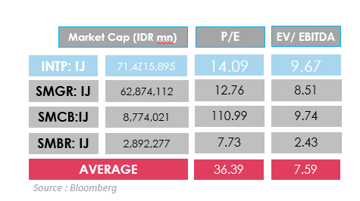
Alternatives
POLITICAL RISKS & STRATEGIC UNCERTAINTY IN ILANIA
Alternatives
Decision tree option value
Other consideration
Consolidate & Expand
S$ (56) Bil
Nationalization
Stay the Course
S$ 136 Bil
Market Instability
Sell-off & Walk away
S$ 73 Bil
Bartini’s Offer: Can’t be retrieved
Mobile Turkish: share-to-share exchange worth S$ 85,000m
LEGAL WRANGLING IN NAKOLIA
UNCERTAINTY IN ILANIA
SSC IN SADIMBA
MCOM CAPITAL STRUCTURE
MOBILE OPERATOR LICENSE IN CHININSIA

Slide 21
Alternatives
POLITICAL RISKS & STRATEGIC UNCERTAINTY IN ILANIA
Alternatives
Decision tree option value
Other consideration
Consolidate & Expand
S$ (56) Bil
Nationalization
Stay the Course
S$ 136 Bil
Market Instability
Sell-off & Walk away
S$ 73 Bil
Bartini’s Offer: Can’t be retrieved
Mobile Turkish: share-to-share exchange worth S$ 85,000m
LEGAL WRANGLING IN NAKOLIA
UNCERTAINTY IN ILANIA
SSC IN SADIMBA
MCOM CAPITAL STRUCTURE
MOBILE OPERATOR LICENSE IN CHININSIA

Slide 22
Alternatives
POLITICAL RISKS & STRATEGIC UNCERTAINTY IN ILANIA
Alternatives
Decision tree option value
Other consideration
Consolidate & Expand
S$ (56) Bil
Nationalization
Stay the Course
S$ 136 Bil
Market Instability
Sell-off & Walk away
S$ 73 Bil
Bartini’s Offer: Can’t be retrieved
Mobile Turkish: share-to-share exchange worth S$ 85,000m
LEGAL WRANGLING IN NAKOLIA
UNCERTAINTY IN ILANIA
SSC IN SADIMBA
MCOM CAPITAL STRUCTURE
MOBILE OPERATOR LICENSE IN CHININSIA

Slide 23
Alternatives
POLITICAL RISKS & STRATEGIC UNCERTAINTY IN ILANIA
Alternatives
Decision tree option value
Other consideration
Consolidate & Expand
S$ (56) Bil
Nationalization
Stay the Course
S$ 136 Bil
Market Instability
Sell-off & Walk away
S$ 73 Bil
Bartini’s Offer: Can’t be retrieved
Mobile Turkish: share-to-share exchange worth S$ 85,000m
LEGAL WRANGLING IN NAKOLIA
UNCERTAINTY IN ILANIA
SSC IN SADIMBA
MCOM CAPITAL STRUCTURE
MOBILE OPERATOR LICENSE IN CHININSIA

Slide 24
Alternatives
POLITICAL RISKS & STRATEGIC UNCERTAINTY IN ILANIA
Alternatives
Decision tree option value
Other consideration
Consolidate & Expand
S$ (56) Bil
Nationalization
Stay the Course
S$ 136 Bil
Market Instability
Sell-off & Walk away
S$ 73 Bil
Bartini’s Offer: Can’t be retrieved
Mobile Turkish: share-to-share exchange worth S$ 85,000m
LEGAL WRANGLING IN NAKOLIA
UNCERTAINTY IN ILANIA
SSC IN SADIMBA
MCOM CAPITAL STRUCTURE
MOBILE OPERATOR LICENSE IN CHININSIA

Slide 25
Action Plan
POLITICAL RISKS & STRATEGIC UNCERTAINTY IN ILANIA
#1
#2
Sell Turkish mobile share
Pay the Fine
or
Expand
LEGAL WRANGLING IN NAKOLIA
UNCERTAINTY IN ILANIA
SSC IN SADIMBA
MCOM CAPITAL STRUCTURE
MOBILE OPERATOR LICENSE IN CHININSIA

Slide 26

Issue #3 : Shared Service Center in Sadimba
Trade-off: Cost saving vs. People’s job
Declining revenue and operating performance
SSC
S$6,600
In 2014, Sadimba
saving
Further expand SSC for other supporting functions
LEGAL WRANGLING IN NAKOLIA
UNCERTAINTY IN ILANIA
SSC IN SADIMBA
MCOM CAPITAL STRUCTURE
MOBILE OPERATOR LICENSE IN CHININSIA

Slide 27
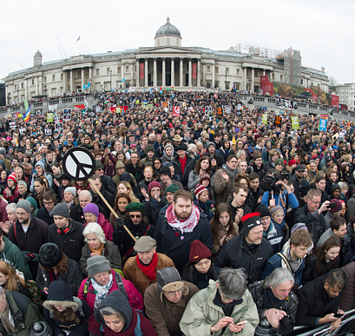
The Impacts
The protests
Market’s Protests
&
Employee’s fear
To continue or not to continue?
LEGAL WRANGLING IN NAKOLIA
UNCERTAINTY IN ILANIA
SSC IN SADIMBA
MCOM CAPITAL STRUCTURE
MOBILE OPERATOR LICENSE IN CHININSIA
Notes:
36% turnover?? Minta datanya

Slide 28
The considerations
Operational and financial points of consideration for decision making
OPERATIONAL
Working structure: effective
Task delegation: simpler
Economies of Scale
LEGAL WRANGLING IN NAKOLIA
UNCERTAINTY IN ILANIA
SSC IN SADIMBA
MCOM CAPITAL STRUCTURE
MOBILE OPERATOR LICENSE IN CHININSIA

Slide 29
The considerations
Operational and financial points of consideration for decision making
Cost Efficiency Calculation
Nakolia, Sadimba, all other countries → save S$ 7,805m
Without Nakolia → save S$ 4,970m
LEGAL WRANGLING IN NAKOLIA
UNCERTAINTY IN ILANIA
SSC IN SADIMBA
MCOM CAPITAL STRUCTURE
MOBILE OPERATOR LICENSE IN CHININSIA

Slide 30
Recommendations
WHAT MCOM SHOULD DO TO SOLVE THE ISSUE
GRADUAL EXPANSION OF
SHARED SERVICE CENTER
Strategy of implementation:
Step by Step
SADIMBA
NAKOLIA
OTHER
LEGAL WRANGLING IN NAKOLIA
UNCERTAINTY IN ILANIA
SSC IN SADIMBA
MCOM CAPITAL STRUCTURE
MOBILE OPERATOR LICENSE IN CHININSIA
Notes:
The first alternatives for this issue is to continue pursue court action to challenge the fine which you have been done. We can hope there will be further fine reduction, and stalling to get the money to pay the fine. However, doing this action could worsen your reputation in the eye of our stakeholders.
The second alternative is to finish the court action and accept the US$ 3.9 bil fine. By doing this action, we can gain our shareholders, government, and the market’s trust.

Slide 31

Issue #4: Nakolia fine and MCOM capital structure
Funding options for fine payments
Financial Strategy
External Audit
Financials adjustments
Audit considerations
Funding structure for fine
LEGAL WRANGLING IN NAKOLIA
UNCERTAINTY IN ILANIA
SSC IN SADIMBA
MCOM CAPITAL STRUCTURE
MOBILE OPERATOR LICENSE IN CHININSIA

Slide 32
Adjusted Financials
Matters to consider
Matters
Amount
Recognition of fine ( IAS 37)
Adjustment
S$ 58 billion
Recording quote from tower sale
Reclassification
S$ 5 million
Reclassification of tower (IFRS 5)
Reclassification
S$ 20 billion
LEGAL WRANGLING IN NAKOLIA
UNCERTAINTY IN ILANIA
SSC IN SADIMBA
MCOM CAPITAL STRUCTURE
MOBILE OPERATOR LICENSE IN CHININSIA

Slide 33
Adjusted Financials
Matters to consider
Matters
Amount
Operating Lease
No current impact in financial statement
Goodwill impairment (IAS 36)
Adjustment
$ 4862
Loss S$85.520 Billion
*(exchange rate S$14.87/US$ (S$3.9 billion = S$58 billion)
LEGAL WRANGLING IN NAKOLIA
UNCERTAINTY IN ILANIA
SSC IN SADIMBA
MCOM CAPITAL STRUCTURE
MOBILE OPERATOR LICENSE IN CHININSIA

Slide 34
Audit Considerations
Guide to risk assessments
Going Concern (AU 314)
Substantial doubt of Illania Business’ ability to continue
Materiality in Planning and Performing in multi-locations
Group materiality should be less than 1.4%
LEGAL WRANGLING IN NAKOLIA
UNCERTAINTY IN ILANIA
SSC IN SADIMBA
MCOM CAPITAL STRUCTURE
MOBILE OPERATOR LICENSE IN CHININSIA
Notes:
36% turnover?? Minta datanya

Slide 35
Capital Structuring
Best funding options for Nakolia Fine
Share Issuance
Borrowing (Bank or Loan)
Turkish Mobile Share
Sale and Lease
Time and Terms
Slow, agreement
Quick
Unknown
Quick,
Sale accepted
Acquiring Cost
Expensive,
underwriter
Expensive,
low rating
Medium,
sale admin cost
Cheap,
admin cost
Amount available
Little, unfavorable price
Adequate
S$ 85000m
Adequate
S$ 297000m
Adequate
Other considerations
Strengthen BS, Min volatility
Weaken BS, Tax reduction
Operating lease vs. depre exp
Tax reduction
LEGAL WRANGLING IN NAKOLIA
UNCERTAINTY IN ILANIA
SSC IN SADIMBA
MCOM CAPITAL STRUCTURE
MOBILE OPERATOR LICENSE IN CHININSIA

Slide 36
Capital Structuring
Best funding options for Nakolia Fine
Borrowing (Bank or Loan)
Turkish Mobile Share
Sale and Lease
Share Issuance
Sale and Lease
5
5
5
1.5
2
5
3.6
1
4
2
1
3.7
Time and Terms (30%)
4
5
4
5
3
4
Acquiring Cost (50%)
2
3
2
5
5
5
Amount available (20%)
1
5
5
1
5
Strategic Consideration
Minimizing Earning Volatility
LEGAL WRANGLING IN NAKOLIA
UNCERTAINTY IN ILANIA
SSC IN SADIMBA
MCOM CAPITAL STRUCTURE
MOBILE OPERATOR LICENSE IN CHININSIA

Slide 37

Issue #5: Mobile Operator License in Chininsia
Expansion to World’s 4th largest mobile market country
Expansion Opportunity
to
Chininsia
LEGAL WRANGLING IN NAKOLIA
UNCERTAINTY IN ILANIA
SSC IN SADIMBA
MCOM CAPITAL STRUCTURE
MOBILE OPERATOR LICENSE IN CHININSIA

Slide 38
The Opportunity
Renewal of Four Big Mobile Operator Licenses
Cloudnet
+
InterCom
+
AxtonTel
+
Bartini
82%
Market Share
License will expire by end of 2017
LEGAL WRANGLING IN NAKOLIA
UNCERTAINTY IN ILANIA
SSC IN SADIMBA
MCOM CAPITAL STRUCTURE
MOBILE OPERATOR LICENSE IN CHININSIA

Slide 39
Issue #5: Mobile Operator License in Chininsia
SUITABILITY
ACCEPTABILITY
FEASIBILITY
Change of Political Power
305 mio Subscriber
MCOM Chininsia Limited
“Internet Accesss for All” Program
Probability of
Winning
Mobile Number Portability
Acquire CloudNet
Intense Price Competition
LEGAL WRANGLING IN NAKOLIA
UNCERTAINTY IN ILANIA
SSC IN SADIMBA
MCOM CAPITAL STRUCTURE
MOBILE OPERATOR LICENSE IN CHININSIA

Slide 40
Issue #5: Mobile Operator License in Chininsia
SUITABILITY
ACCEPTABILITY
FEASIBILITY
Change of Political Power
305 mio Subscriber
MCOM Chininsia Limited
“Internet Accesss for All” Program
Probability of
Winning
Mobile Number Portability
Acquire CloudNet
Intense Price Competition
LEGAL WRANGLING IN NAKOLIA
UNCERTAINTY IN ILANIA
SSC IN SADIMBA
MCOM CAPITAL STRUCTURE
MOBILE OPERATOR LICENSE IN CHININSIA

Slide 41
Issue #5: Mobile Operator License in Chininsia
SUITABILITY
ACCEPTABILITY
FEASIBILITY
Change of Political Power
305 mio Subscriber
MCOM Chininsia Limited
“Internet Accesss for All” Program
Probability of
Winning
Mobile Number Portability
Acquire CloudNet
Intense Price Competition
LEGAL WRANGLING IN NAKOLIA
UNCERTAINTY IN ILANIA
SSC IN SADIMBA
MCOM CAPITAL STRUCTURE
MOBILE OPERATOR LICENSE IN CHININSIA

Slide 42
The Acceptability
#1: Change of Political Power
POPULIST PARTY:
FAVORABLE
to local company or not?
LEGAL WRANGLING IN NAKOLIA
UNCERTAINTY IN ILANIA
SSC IN SADIMBA
MCOM CAPITAL STRUCTURE
MOBILE OPERATOR LICENSE IN CHININSIA
Notes:
This slide can be reworded to be clearer.

Slide 43
The Acceptability
#2: Probability of Winning
Old
New
Tender Price S$ 4,335m for new license with 40% chance
Tender Price S$ 2,550m for foreign company with 4% chance
LEGAL WRANGLING IN NAKOLIA
UNCERTAINTY IN ILANIA
SSC IN SADIMBA
MCOM CAPITAL STRUCTURE
MOBILE OPERATOR LICENSE IN CHININSIA

Slide 44
The Acceptability
#3: Intense price competition
Intense
Price
Competition
Because of
MNP
Mobile Number Portability
LEGAL WRANGLING IN NAKOLIA
UNCERTAINTY IN ILANIA
SSC IN SADIMBA
MCOM CAPITAL STRUCTURE
MOBILE OPERATOR LICENSE IN CHININSIA

Slide 45
Issue #5: Mobile Operator License in Chininsia
SUITABILITY
ACCEPTABILITY
FEASIBILITY
Change of Political Power
305 mio Subscriber
MCOM Chininsia Limited
“Internet Accesss for All” Program
Probability of
Winning
Mobile Number Portability
Acquire CloudNet
Intense Price Competition
LEGAL WRANGLING IN NAKOLIA
UNCERTAINTY IN ILANIA
SSC IN SADIMBA
MCOM CAPITAL STRUCTURE
MOBILE OPERATOR LICENSE IN CHININSIA

Slide 46
Recommendation
Expand
How?
to Chininsia
LEGAL WRANGLING IN NAKOLIA
UNCERTAINTY IN ILANIA
SSC IN SADIMBA
MCOM CAPITAL STRUCTURE
MOBILE OPERATOR LICENSE IN CHININSIA

Slide 47
Issue #5: Mobile Operator License in Chininsia
SUITABILITY
ACCEPTABILITY
FEASIBILITY
Change of Political Power
305 mio Subscriber
MCOM Chininsia Limited
“Internet Accesss for All” Program
Probability of
Winning
Mobile Number Portability
Acquire CloudNet
Intense Price Competition
LEGAL WRANGLING IN NAKOLIA
UNCERTAINTY IN ILANIA
SSC IN SADIMBA
MCOM CAPITAL STRUCTURE
MOBILE OPERATOR LICENSE IN CHININSIA

Slide 48


The Feasibility
AHP
Analytical Hierarchy Process
LEGAL WRANGLING IN NAKOLIA
UNCERTAINTY IN ILANIA
SSC IN SADIMBA
MCOM CAPITAL STRUCTURE
MOBILE OPERATOR LICENSE IN CHININSIA

Slide 49
Issue #5: Mobile Operator License in Chininsia
SUITABILITY
ACCEPTABILITY
FEASIBILITY
Change of Political Power
305 mio Subscriber
MCOM Chininsia Limited
“Internet Accesss for All” Program
Probability of
Winning
Mobile Number Portability
Acquire CloudNet
Intense Price Competition
LEGAL WRANGLING IN NAKOLIA
UNCERTAINTY IN ILANIA
SSC IN SADIMBA
MCOM CAPITAL STRUCTURE
MOBILE OPERATOR LICENSE IN CHININSIA

Slide 50
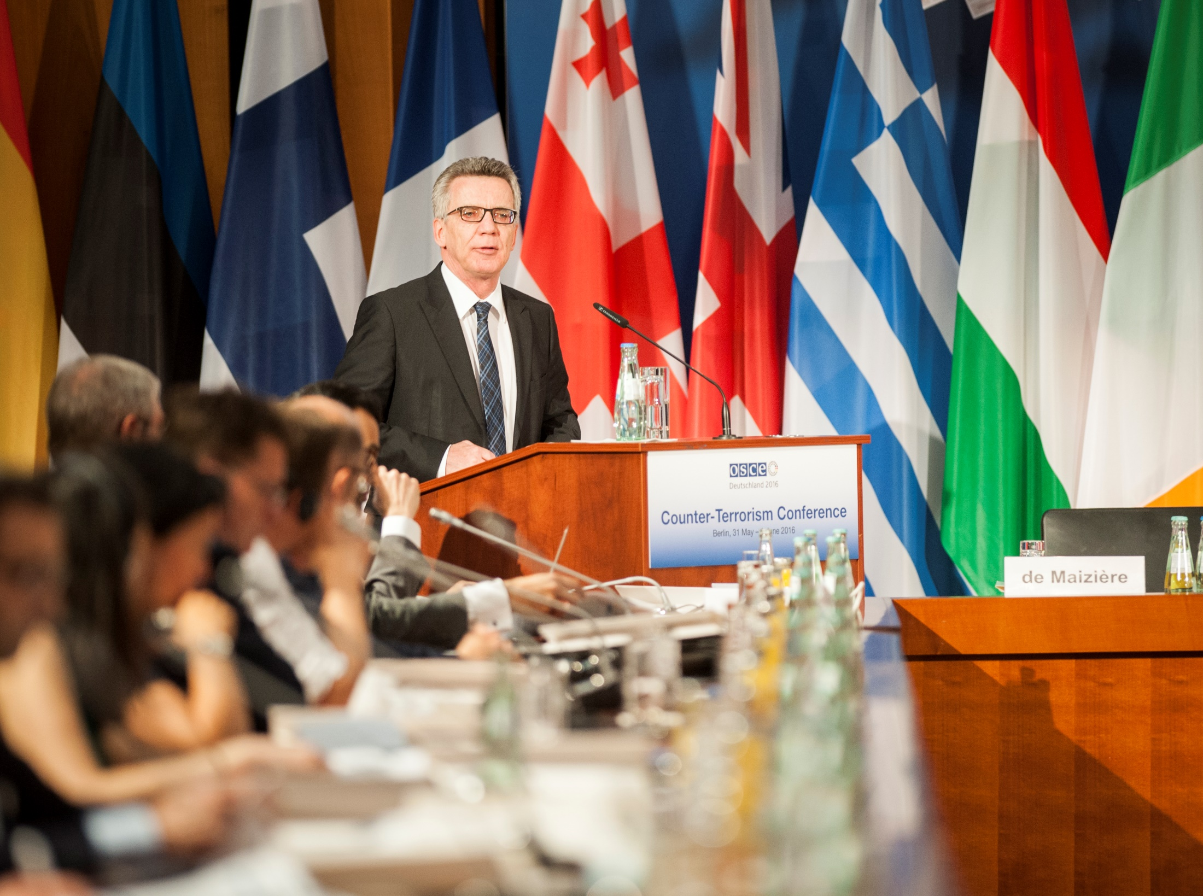
Ethical Issues
LEGAL WRANGLING IN NAKOLIA
Shared Service Center IN SADIMBA
ILANIA CONSUMER’S PRIVACY

Slide 51
Ethical Issue #1: Legal Wrangling in Nakolia
The Issue
MCOM unable
to fullfill
NTRA
Requirement
Blokanda Issue
Threatened
MCOM
Reputation
Leads to
LEGAL WRANGLING IN NAKOLIA
SSC IN SADIMBA
ILANIA CONSUMER’S PRIVACY

Slide 52
Ethical Issue #1: Legal Wrangling in Nakolia
Advice
Implement principle of good ethics and corporate governance
Press conference to apologize
Inform currently unregistered users to register
LEGAL WRANGLING IN NAKOLIA
SSC IN SADIMBA
ILANIA CONSUMER’S PRIVACY

Slide 53
Ethical Issue #2: Shared Service Center in Sadimba
The Issue
SSC
Shared Service Center
Employee Lay Off
LEGAL WRANGLING IN NAKOLIA
SSC IN SADIMBA
ILANIA CONSUMER’S PRIVACY

Slide 54
Ethical Issue #2: Shared Service Center in Sadimba
Advice
Press Conference to communicate the causes.
“Lift” & “Shift” method
LEGAL WRANGLING IN NAKOLIA
SSC IN SADIMBA
ILANIA CONSUMER’S PRIVACY

Slide 55
Ethical Issue #2: Shared Service Center in Sadimba
Advice
Press Conference to communicate the causes.
“Lift” & “Shift” method
LEGAL WRANGLING IN NAKOLIA
SSC IN SADIMBA
ILANIA CONSUMER’S PRIVACY

Slide 56
Ethical Issue #3: ILANIA CONSUMER’S PRIVACY
The Issue
Ilania Regime, strike by Arab Spring
Asking Personal Information, as evience for striking action
Civil liberty watchdog is asking MCOM to withdraw from Ilania to show commitment to human rights.
LEGAL WRANGLING IN NAKOLIA
SSC IN SADIMBA
ILANIA CONSUMER’S PRIVACY

Slide 57
Ethical Issue #3: ILANIA CONSUMER’S PRIVACY
Advice
MCOM should withdraw from Ilania because of:
Political instability
Practice in Ilania being no longer in accordance with MCOM’s Value
LEGAL WRANGLING IN NAKOLIA
SSC IN SADIMBA
ILANIA CONSUMER’S PRIVACY

Slide 58

Conclusion
BUSINESS ISSUES
#1
To settle court process in Nakolia, ASAP
#2
Sell off and walk out from Ilania.
Continue to process the shared service center in Sadimba.
#3
#4
Sell and leaseback the towers in Nakolia.
#5
Acquire CloudNet = best strategy to enter Chininsia

Slide 59
Conclusion
BUSINESS ISSUES
#1
To settle court process in Nakolia, ASAP
#2
Sell off and walk out from Ilania.
Continue to process the shared service center in Sadimba.
#3
#4
Sell and leaseback the towers in Nakolia.
#5
Acquire CloudNet = best strategy to enter Chininsia

Slide 60
Conclusion
BUSINESS ISSUES
#1
To settle court process in Nakolia, ASAP
#2
Sell off and walk out from Ilania.
Continue to process the shared service center in Sadimba.
#3
#4
Sell and leaseback the towers in Nakolia.
#5
Acquire CloudNet = best strategy to enter Chininsia

Slide 61
Conclusion
BUSINESS ISSUES
#1
To settle court process in Nakolia, ASAP
#2
Sell off and walk out from Ilania.
Continue to process the shared service center in Sadimba.
#3
#4
Sell and leaseback the towers in Nakolia.
#5
Acquire CloudNet = best strategy to enter Chininsia

Slide 62
Conclusion
BUSINESS ISSUES
#1
To settle court process in Nakolia, ASAP
#2
Sell off and walk out from Ilania.
Continue to process the shared service center in Sadimba.
#3
#4
Sell and leaseback the towers in Nakolia.
#5
Acquire CloudNet = best strategy to enter Chininsia

Slide 63
Conclusion
BUSINESS ISSUES
#1
To settle court process in Nakolia, ASAP
#2
Sell off and walk out from Ilania.
Continue to process the shared service center in Sadimba.
#3
#4
Sell and leaseback the towers in Nakolia.
#5
Acquire CloudNet = best strategy to enter Chininsia

Slide 64
Conclusion
ETHICAL ISSUES
#1
Have two ways communication.
#2
Privacy Protection.

Slide 65
MCOM COMPANY REPORT
Issues & Recommendations

Slide 66
Appendix: Security Crisis & Legal Wrangling in Nakolia
Noncompliance leading to fine and tarnished image
APPENDIX
Security crisis & legal wrangling in Nakolia
LEGAL WRANGLING IN NAKOLIA
UNCERTAINTY IN ILANIA
SSC IN SADIMBA
MCOM CAPITAL STRUCTURE
MOBILE OPERATOR LICENSE IN CHININSIA

Slide 67
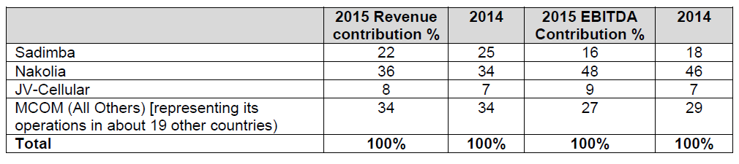
APPENDIX
LEGAL WRANGLING IN NAKOLIA
UNCERTAINTY IN ILANIA
SSC IN SADIMBA
MCOM CAPITAL STRUCTURE
MOBILE OPERATOR LICENSE IN CHININSIA

Slide 68
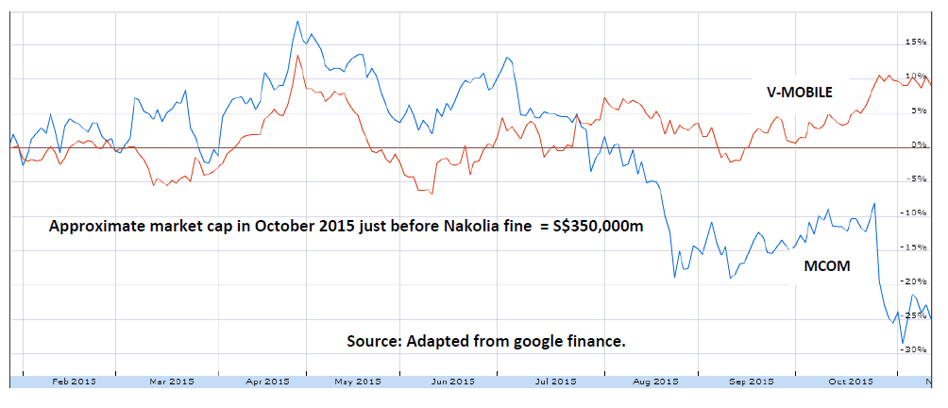
APPENDIX
LEGAL WRANGLING IN NAKOLIA
UNCERTAINTY IN ILANIA
SSC IN SADIMBA
MCOM CAPITAL STRUCTURE
MOBILE OPERATOR LICENSE IN CHININSIA

Slide 69
Appendix: Political Risks & Strategic Uncertainty in Ilania
APPENDIX
Political risks & strategic uncertainty in Ilania
LEGAL WRANGLING IN NAKOLIA
UNCERTAINTY IN ILANIA
SSC IN SADIMBA
MCOM CAPITAL STRUCTURE
MOBILE OPERATOR LICENSE IN CHININSIA

Slide 70
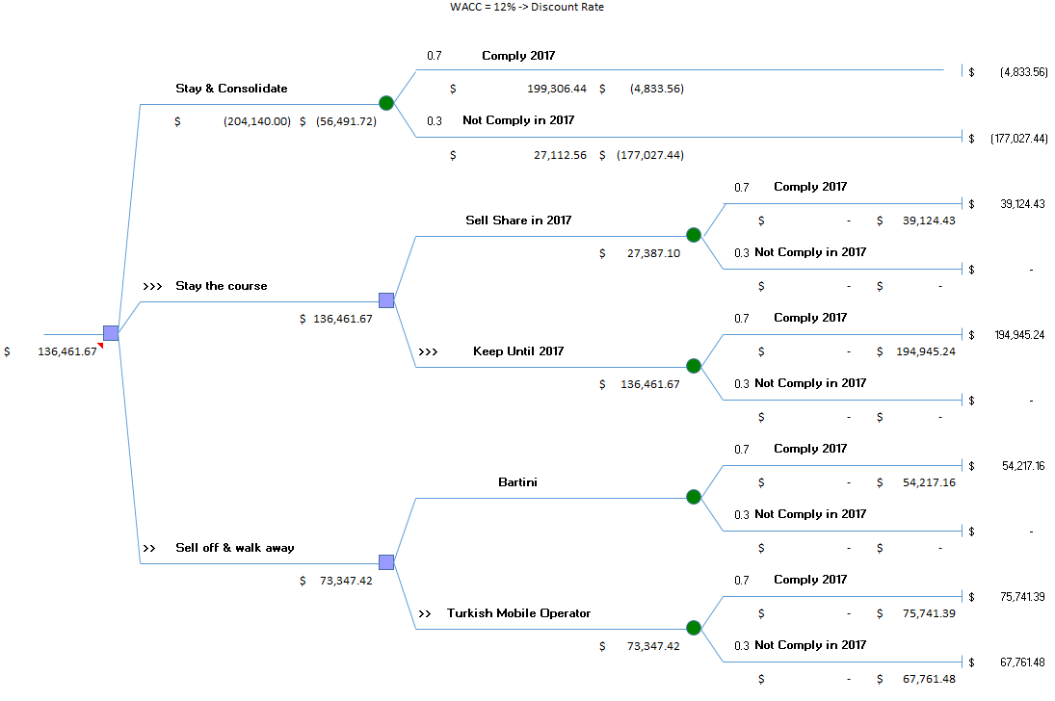
APPENDIX
Decision tree
LEGAL WRANGLING IN NAKOLIA
UNCERTAINTY IN ILANIA
SSC IN SADIMBA
MCOM CAPITAL STRUCTURE
MOBILE OPERATOR LICENSE IN CHININSIA

Slide 71
Appendix: Shared Service Center in Sadimba
Trade-off: Cost saving vs. People’s job
APPENDIX
Shared service center in Sadimba
LEGAL WRANGLING IN NAKOLIA
UNCERTAINTY IN ILANIA
SSC IN SADIMBA
MCOM CAPITAL STRUCTURE
MOBILE OPERATOR LICENSE IN CHININSIA

Slide 72
APPENDIX
LEGAL WRANGLING IN NAKOLIA
UNCERTAINTY IN ILANIA
SSC IN SADIMBA
MCOM CAPITAL STRUCTURE
MOBILE OPERATOR LICENSE IN CHININSIA

Slide 73
Appendix: Nakolia fine and MCOM capital structure
Funding options for fine payments
APPENDIX
Nakolia fine & MCOM capital structure
LEGAL WRANGLING IN NAKOLIA
UNCERTAINTY IN ILANIA
SSC IN SADIMBA
MCOM CAPITAL STRUCTURE
MOBILE OPERATOR LICENSE IN CHININSIA

Slide 74
APPENDIX
Matters to consider
Matters
Amount
Recognition of fine ( IAS 37)
Nakolia fine expense (dr)
Allowance for court settlement (cr)
Paid fine:
Nakolia Contingent Liability (dr)
Cash/Bank (cr)
Loss of $13,214 in 2015 (before impairment and goodwill)
S$ 58 billion
Reclassification of tower sale (IFRS 5)
Asset-available for sale (dr)
Asset (cr)
S$ 20 billion
Recording quote from tower sale
Cash (dr)
Asset-available for sale (cr)
S$ 5 million
LEGAL WRANGLING IN NAKOLIA
UNCERTAINTY IN ILANIA
SSC IN SADIMBA
MCOM CAPITAL STRUCTURE
MOBILE OPERATOR LICENSE IN CHININSIA

Slide 75
APPENDIX
Matters to consider
Matters
Amount
Operating Lease
Paid March 2016, no journal entry
Disclosed in notes to financial statement
Sale and lease-back:
Non-core asset efficiency
Reduction on payment of annual income tax due to increase of lease expense
No current impact in financial statement
Goodwill impairment (IAS 36)
Impairment loss goodwill (dr)
Goodwill and Intangible Asset (cr)
Worsen group income: loss S$85.520 billion
(exchange rate S$14.87/US$ (S$3.9 billion = S$58 billion)
$ 4862
LEGAL WRANGLING IN NAKOLIA
UNCERTAINTY IN ILANIA
SSC IN SADIMBA
MCOM CAPITAL STRUCTURE
MOBILE OPERATOR LICENSE IN CHININSIA

Slide 76
Appendix: Mobile Operator License in Chininsia
Expansion to World’s 4th largest mobile market country
APPENDIX
Expansion Opportunity
to
Chininsia
LEGAL WRANGLING IN NAKOLIA
UNCERTAINTY IN ILANIA
SSC IN SADIMBA
MCOM CAPITAL STRUCTURE
MOBILE OPERATOR LICENSE IN CHININSIA

Slide 77

APPENDIX
CRITERIA
LEGAL WRANGLING IN NAKOLIA
UNCERTAINTY IN ILANIA
SSC IN SADIMBA
MCOM CAPITAL STRUCTURE
MOBILE OPERATOR LICENSE IN CHININSIA

Slide 78

APPENDIX
Cost CloudNet : S$ 5,225m
Cost MCOM Chininsia : S$ 4,320m x 38% + S$ 2,565m x 72% = S$ 3,402m
S$ 5,225m VS S$ 3,402m
Cloudnet 1,54x higher cost
LEGAL WRANGLING IN NAKOLIA
UNCERTAINTY IN ILANIA
SSC IN SADIMBA
MCOM CAPITAL STRUCTURE
MOBILE OPERATOR LICENSE IN CHININSIA

Slide 79

APPENDIX
Probability of CloudNet :
40% Acceptance x 38% + 60% Acceptance x 72% = 58.4%
Probability of MCOM Chininsia :
40% Acceptance x 38% + 4% Acceptance x 72% = 18.4%
58.4 % VS 18.4 %
Cloudnet 3,23x better
LEGAL WRANGLING IN NAKOLIA
UNCERTAINTY IN ILANIA
SSC IN SADIMBA
MCOM CAPITAL STRUCTURE
MOBILE OPERATOR LICENSE IN CHININSIA

Slide 80

APPENDIX
Profit Certainty of CloudNet :
S$1,710m x 38% + S$6,262m x 72% = S$ 5,158.4
Profit Certainty of MCOM Chininsia :
?
S$ 5,158.4 % VS ?????
Cloudnet 3,23x better
LEGAL WRANGLING IN NAKOLIA
UNCERTAINTY IN ILANIA
SSC IN SADIMBA
MCOM CAPITAL STRUCTURE
MOBILE OPERATOR LICENSE IN CHININSIA

Slide 81
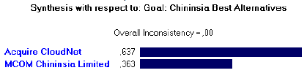
APPENDIX
GO! CLOUDNET
LEGAL WRANGLING IN NAKOLIA
UNCERTAINTY IN ILANIA
SSC IN SADIMBA
MCOM CAPITAL STRUCTURE
MOBILE OPERATOR LICENSE IN CHININSIA

